Slide 1


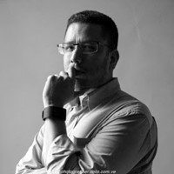


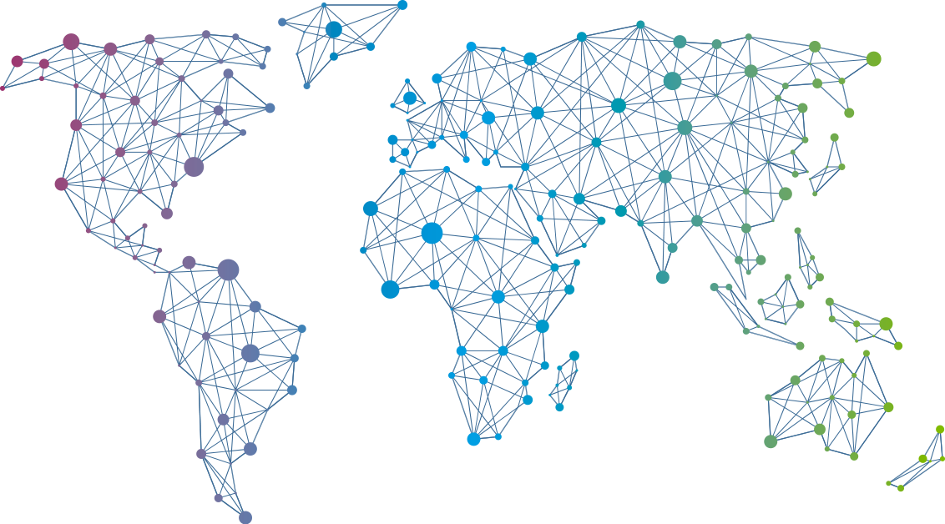

Speaker
Carlos Solís Salazar
Protecting your IT infrastructure with PowerShell
Carlos Solís Salazar
soysoliscarlos
September 16th & 17th
^{Online Event}
Powered By
International Conference

